Slide 1



Fast Graph Convolution Network Based Multi-label Image
Recognition via Cross-modal Fusion
Yangtao Wang, Yanzhao Xie, Yu Liu , Ke Zhou and Xiaocui Li
Wuhan National Laboratory for Optoelectronics,
Huazhong University of Science and Technology, Wuhan, China
Yangtao Wang
CIKM, October 19-23, 2020
29th ACM International Conference on Information and Knowledge Management

Slide 2
Outline
Background
Previous solutions
Proposed Methodology
Experiments
Conclusion
29th ACM International Conference on Information and Knowledge Management

Slide 3
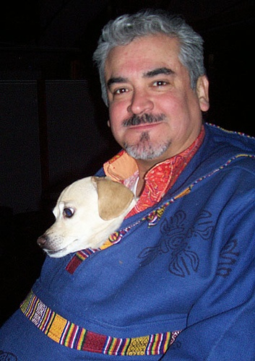
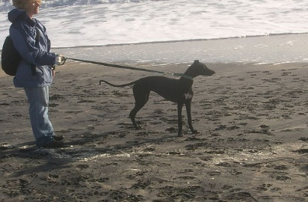
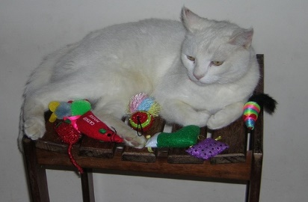
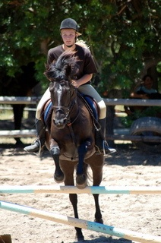
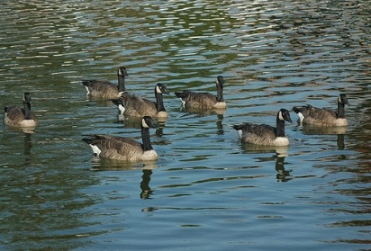

Background
bird
person+dog
person+dog
cat+chair
bird
person+horse
duck+lake
person+boat+sea
single-label image
multi-label image
Multi-label images are more common in the real world and multi-label image recognition has always been a research hotspot in the computer vision field.
29th ACM International Conference on Information and Knowledge Management

Slide 4
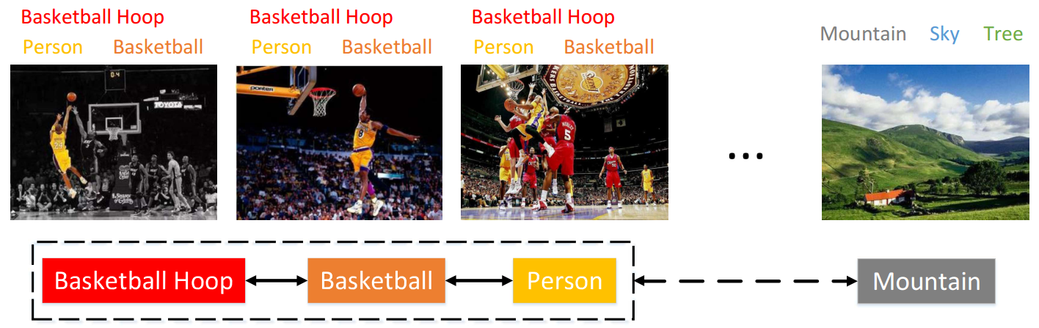
Background
person + basketball + basketball hoop
mountain + sky + tree
objective law in the real world
Basketball + mountain?
Global label dependencies: related objects are more likely to appear in the same image.
29th ACM International Conference on Information and Knowledge Management

Slide 5
Outline
Introduction
Previous solutions
Proposed Methodology
Experiments
Conclusion
29th ACM International Conference on Information and Knowledge Management

Slide 6
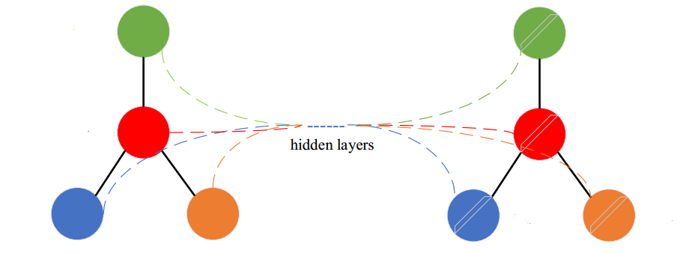
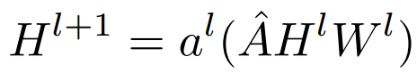
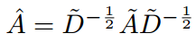
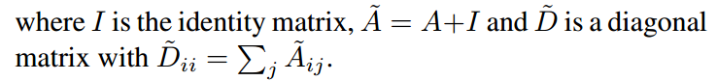
Previous solutions
Graph convolution network (GCN)
H: the feature matrix of nodes
W: the weights of GCN
A: the correlation matrix between nodes
Node features
Correlation matrix
GCN
(the normalized version of A)
Updated node features
29th ACM International Conference on Information and Knowledge Management

Slide 7
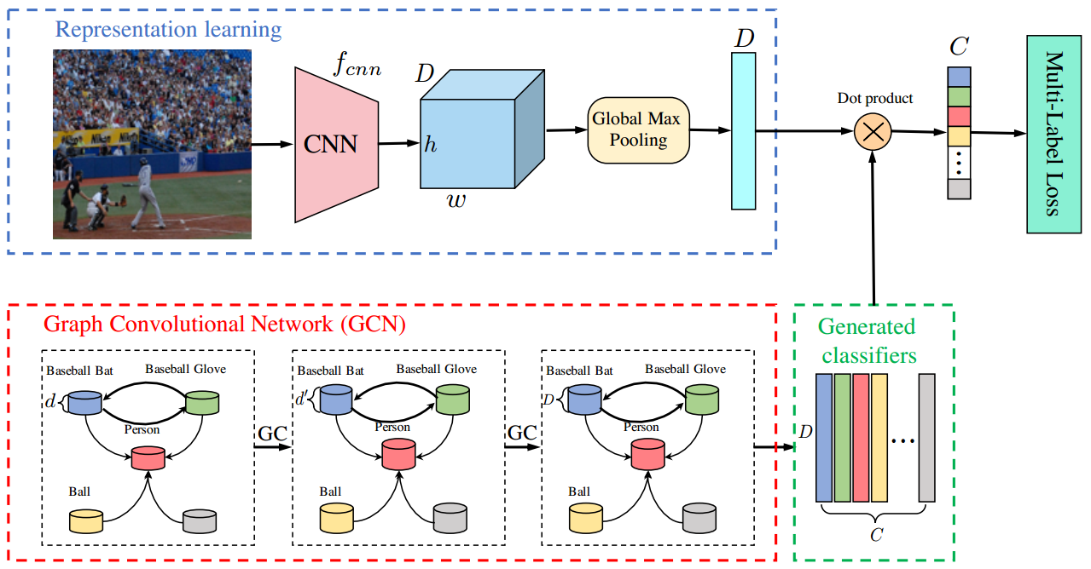

Previous solutions
ML-GCN: Multi-Label Image Recognition with Graph Convolutional Networks (CVPR 2019)
A-GCN is a similar work using DP
Step 1:
CNN
image
image feature
label
GloVe
label embedding
Step 3:
image feature
Step 2:
label statistical information
DP
classification
label embedding
GCN
label co-occurrence embeddings
correlation matrix
label embedding
29th ACM International Conference on Information and Knowledge Management

Slide 8
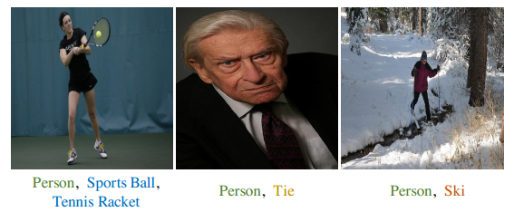
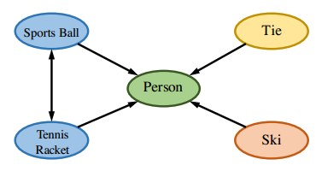
Previous solutions
image feature
image
different modalities
low fusion efficiency
Label co-occurrence embeddings
text
29th ACM International Conference on Information and Knowledge Management

Slide 9
Outline
Introduction
Previous solutions
Proposed Methodology
Experiments
Conclusion
29th ACM International Conference on Information and Knowledge Management

Slide 10
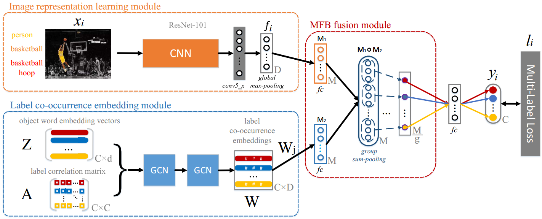
Proposed Methodology
F-GCN: Fast Graph Convolution Network Based Multi-label Image Recognition via Cross-modal Fusion
Image representation from ResNet-101
Label co-occurrence embeddings from GCN
Cross modal fusion via MFB
Overall architecture of F-GCN
29th ACM International Conference on Information and Knowledge Management

Slide 11
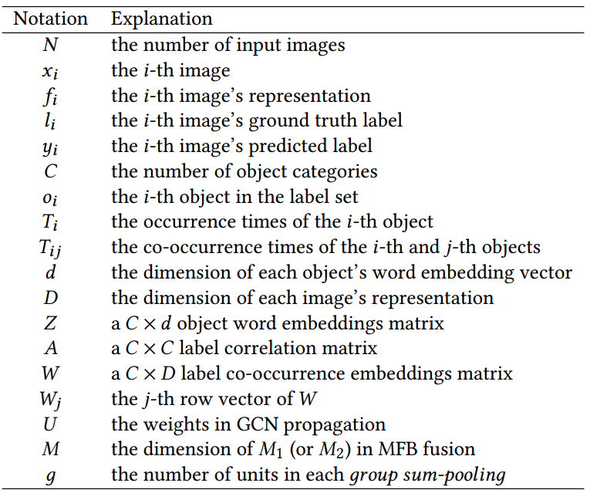
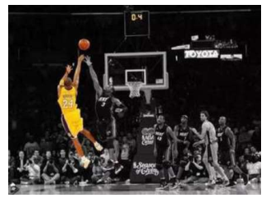

Proposed Methodology
Image feature extraction module:
ResNet-101
D=2048 dimensional feature vector
448 448 size
29th ACM International Conference on Information and Knowledge Management

Slide 12
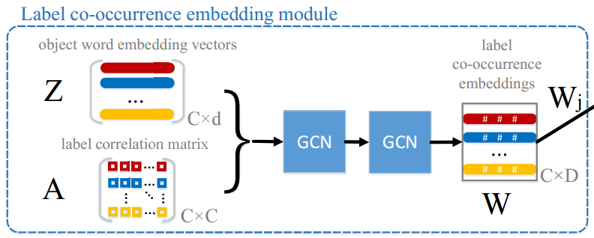
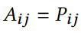
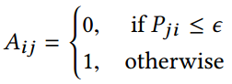
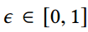
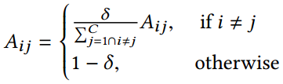
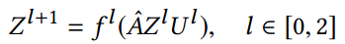
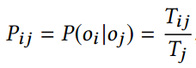
Proposed Methodology
GloVe
1.
label
d=300 dimensional label embedding
GCN propagation
3.
label correlation matrix
2.
29th ACM International Conference on Information and Knowledge Management

Slide 13
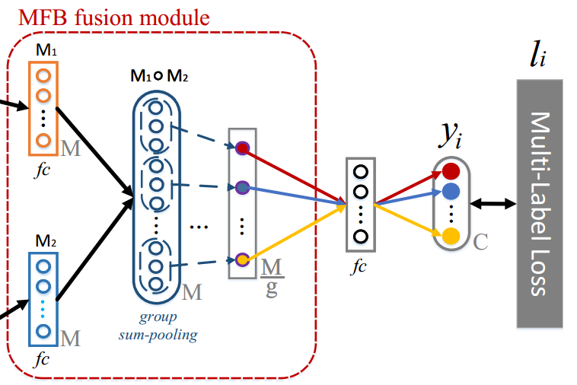
Proposed Methodology
Hadamard product increases the interaction between diﬀerent modal vectors, which promotes the precision of F-GCN.
Group sum-pooling reduces over-fitting and parameters explosion, which speeds up the convergence of F-GCN.
Multi-label classification loss function:
29th ACM International Conference on Information and Knowledge Management

Slide 14
Outline
Introduction
Previous solutions
Proposed Methodology
Experiments
Conclusion
29th ACM International Conference on Information and Knowledge Management

Slide 15
Experiments
Experimental settings:
Tool: Pytorch
Feature extraction model: ResNet-101
GCN: 2 layers
Training: SGD
Learning rate: 0.1 decays by a factor of 10 every 40 epochs
Batchsize: 32
Evaluation metrics:
Convergence efficiency
mAP, AP, Precision, Recall, F1, etc.
Experimental results:
Convergence efficiency comparisons
Results on MS-COCO
Results on Voc2007
Ablation study
Visual retrieval results
Datasets:
MS-COCO
VOC-2007
29th ACM International Conference on Information and Knowledge Management

Slide 16
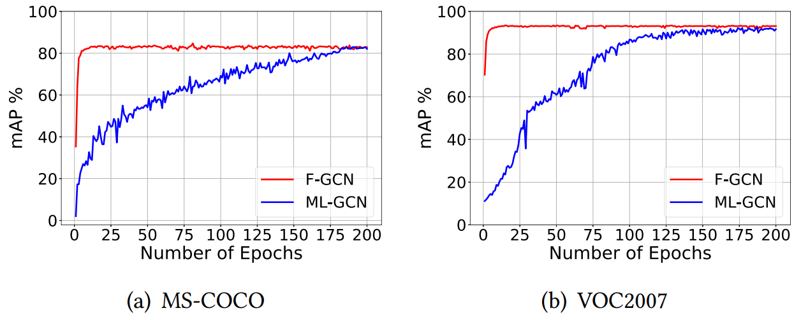
Experiments
1. Convergence efficiency
more than 11 times faster than ML-GCN!
29th ACM International Conference on Information and Knowledge Management

Slide 17
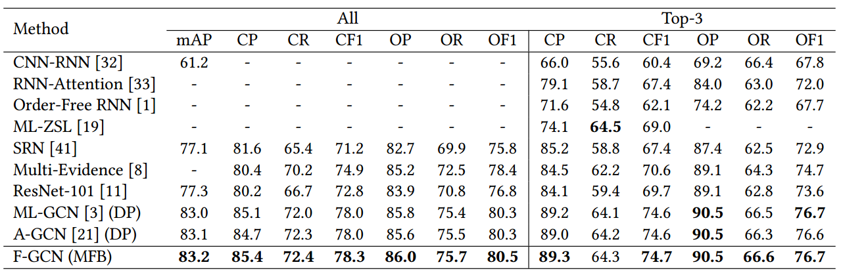
Experiments
2. Results on MS-COCO
F-GCN outperforms all candidate methods on almost all metrics except for a slight result on CR of top-3 labels.
29th ACM International Conference on Information and Knowledge Management

Slide 18
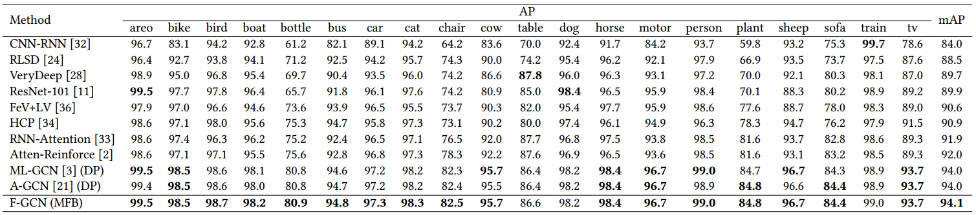
Experiments
3. Results on VOC-2007
Our F-GCN greatly outperforms the other well-known methods in all metrics except for a lower AP result on "table", "dog" and "train" objects.
29th ACM International Conference on Information and Knowledge Management

Slide 19
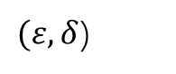
Experiments
4. Ablation study
Different components and parameters:
Feature extraction models
Word embedding methods
Parameters in correlation matrix
GCN layers
Dimension M in cross-modal fusion
Number of units g in group sum pooling
$(ε, δ$)
29th ACM International Conference on Information and Knowledge Management

Slide 20
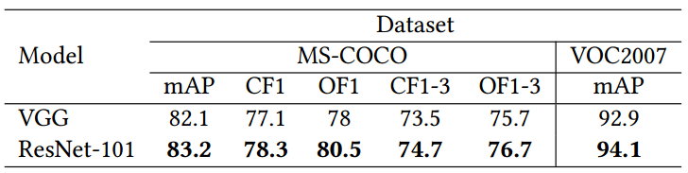
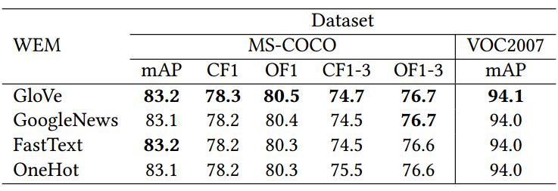
Experiments
4.1 Feature extraction models
ResNet-101 has a strong ability to extract features which will be fused with the label co-occurrence embeddings to generate a better model.
4.2 Word embedding methods
GloVe gains a small advantage than others.
29th ACM International Conference on Information and Knowledge Management

Slide 21
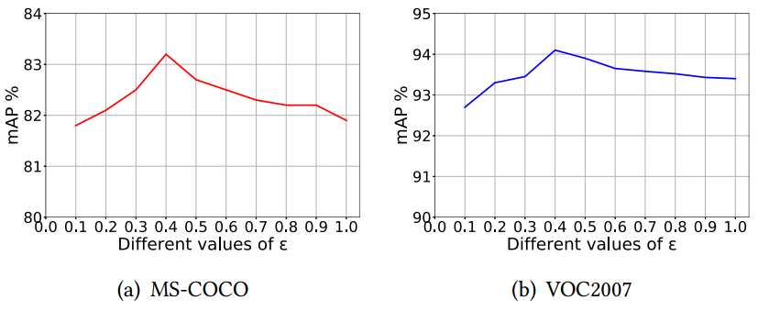
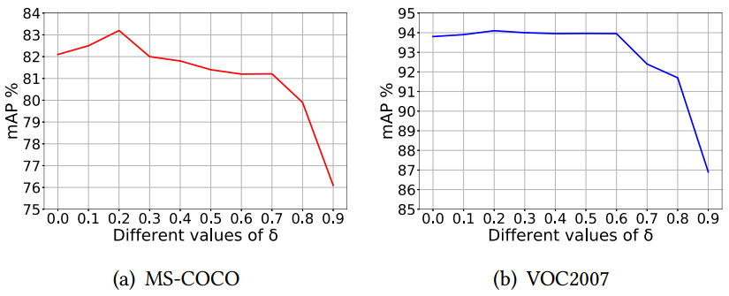
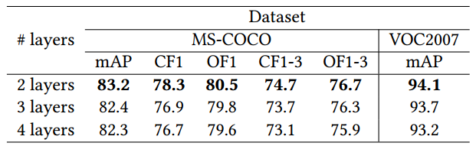
Experiments
4.3 Parameters in correlation matrix
4.4 GCN layers
29th ACM International Conference on Information and Knowledge Management

Slide 22
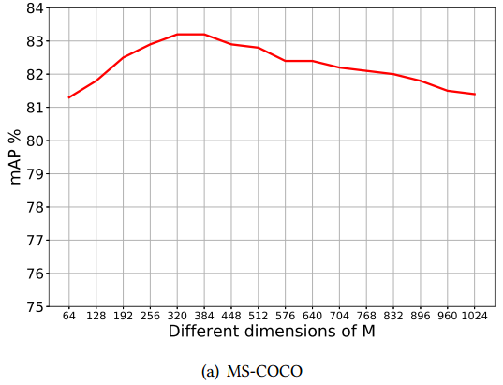
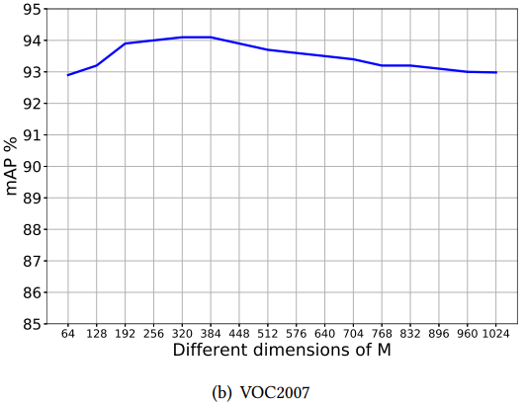
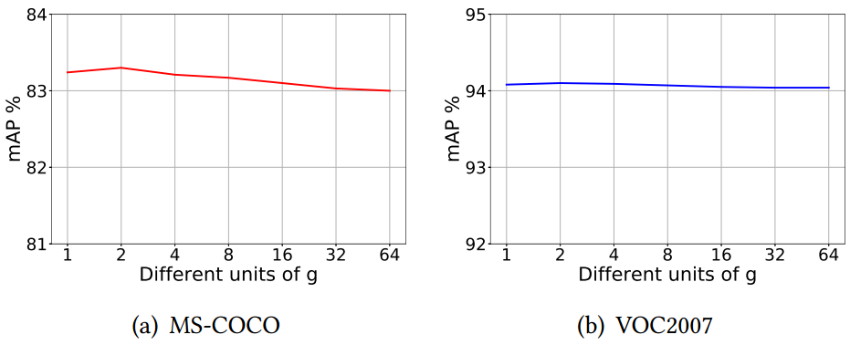
Experiments
4.5 Dimension in cross-modal fusion
4.6 Number of units in group sum pooling
29th ACM International Conference on Information and Knowledge Management

Slide 23
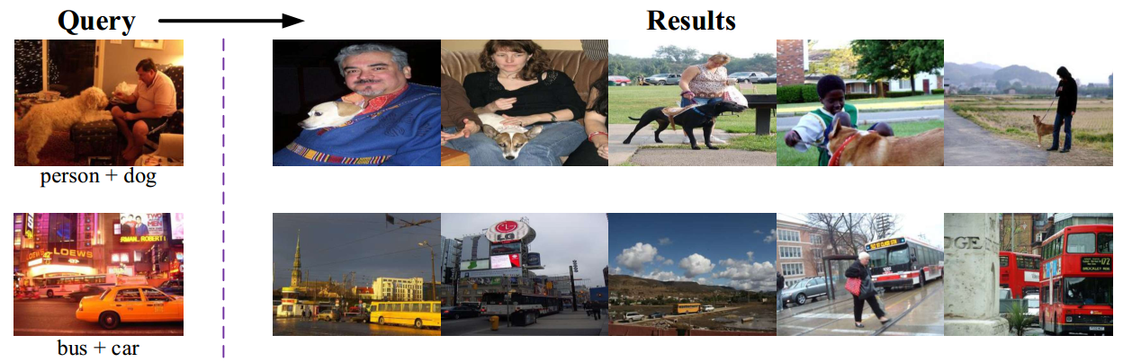
Experiments
5. Visual retrieval results
Top-5 returned results
29th ACM International Conference on Information and Knowledge Management

Slide 24
Outline
Introduction
Previous solutions
Proposed Methodology
Experiments
Conclusion
29th ACM International Conference on Information and Knowledge Management

Slide 25
Conclusion
We propose F-GCN, a fast graph convolution network based multi-label image recognition model.
F-GCN utilizes MFB to efficiently fuse cross-modal vectors to enable an end-to-end model.
Experimental results on MS-COCO and VOC2007 verify that MFB efficiently fuses image representations and label co-occurrence embeddings and thus greatly improves the convergence efficiency of the model. In addition, the performance of image recognition has also been promoted compared with the state-of-the-art methods.
29th ACM International Conference on Information and Knowledge Management

Slide 26
Thank You!
Contact me: ytwbruce@hust.edu.cn
29th ACM International Conference on Information and Knowledge Management

